Slide 1
Data Mining, ID2222
Homework 1
Finding similar items
Group 20: Frano Rajic, Ivan Stresec

Slide 2
Implementation
Python 3, built-in functions and NumPy
5 classes as defined in the homework:
Shingling
CompareSets
MinHash
CompareSignatures
LSH

Slide 3
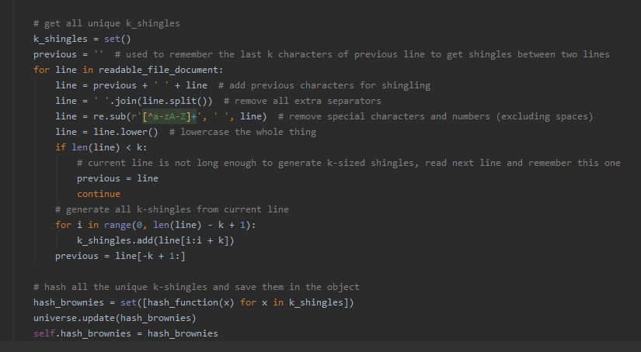
Shingling
generating k-shingles and hashing them
removing special characters and extra spaces...

Slide 4

CompareSets
Jaccard similarity calculation using Python set algebra

Slide 5
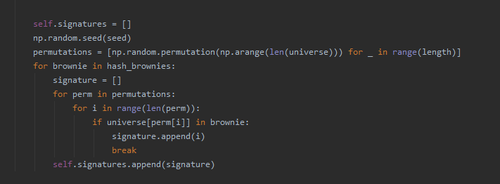
MinHash
create a characteristic matrix using universe
permute (NumPy) and create signatures

Slide 6
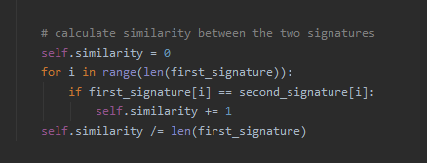
CompareSignatures
simple comparison (number of matching elements)

Slide 7
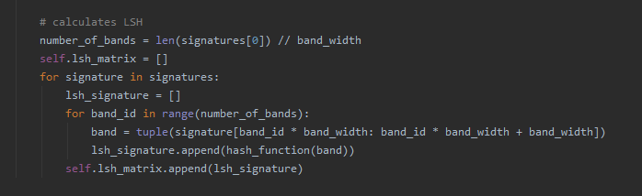
LSH
hashing bands to create new signatures
Python tuple hashing
generating candidate pairs (separate; two for loops)

Slide 8
Science articles (i)
17 articles on neural networks
comparison between:
Jaccard
MinHashing
LSH
generating pairs with similarity ≥ 0.3 with all methods

Slide 9
Science articles (ii)
K = 6, N = 50, B = 5
similar text:
duplicates (Jaccard, MinHash, LSH)
two articles by Koch (Jaccard, MinHash)
two articles by Fei-Fei (Jaccard, MinHash +/-)
LSH is very discriminative, MinHash somewhat random
 | Jaccard | MinHash | LSH
shingling + comparison | 0.71s | 0.50s | 0.49s
comparison | 0.38s | 0.18s | 0.17s
Notes:
What is on the slide… add that similarity can be changed using lower K, you can demonstrate it in PyCharm, stuff like that.

Slide 10
LSH: Croatian song lyrics (i)
database of 58000 Croatian song lyrics
scraped lyrics from tekstovi.net
performed LSH
time: ≈40 minutes
successfully found duplicate and very similar lyrics
Notes:
For our second experiment, we wanted to test LSH on a sort-of real world experiment. We scraped 58 thousand song lyrics from a Croatian website and generated candidates using our implementation of LSH. Finding the candidates took about 40 minutes, but in the end we got a satisfactory result, with candidates really being duplicates of songs detecting identical examples as well as slightly different lyrics.

Slide 11
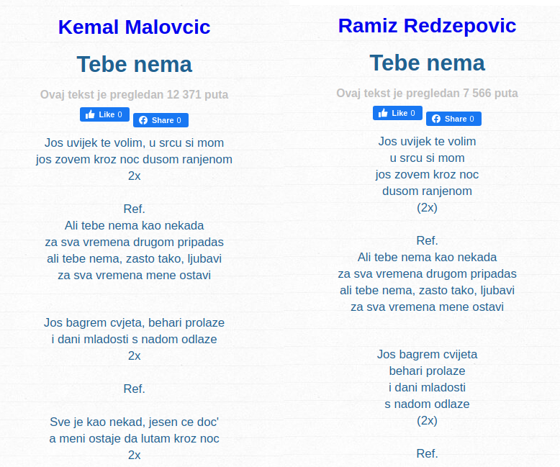
LSH: Croatian song lyrics (ii)
Notes:
Here we can see an example of two songs detected as similar with 0.75% similarity according to LSH. We can see they are duplicate with minor tweaks. All candidate pairs we’re indeed much like this pair, identical or very similar.

Slide 12
Conclusions
size of shingles k <-> similarity
size of MinHash signature <-> accuracy, speed
Jaccard time >> MinHash time
LSH: discriminative and not so quick (our impl.)
Notes:
So just to conclude, we wanted to mention a few important factors. So first of, by changing the size of shingles k, we can manipulate the level of similarity between documents, larger shingles are more discriminative and produce lower similarity between documents. Concerning MinHashing, is we use larger signatures we are likely to produce more accurate estimates of similarity, but the generation of signatures takes more time, we have sort of a tradeoff between speed and accuracy, but we can control it, unlike comparing shingles of some documents manually, which sacrifices all scalability and speed for calculating the correct similarity. That’s also the third point, comparing the shingles to calculate the classic Jaccard similarity takes noticeably longer than using MinHash, in our case it was often twice as long. Finally, when using locality-sensitive hashing LSH, we found it to be very discriminative, in the way that it is likely to reduce similarity, and our implementation of it was just as quick as MinHashing, rendering it somewhat useless.

